Slide 1
C Program Building Process
Compiler
Assembler
Source Program
Pre-processed source code
Assembly code
Object code
Pre-processor
Linker
Executable code
Process Address Space
Program stored in secondary memory as executable image
Loader
Main Memory

Slide 2
Loaders
A loader is a system software program that performs the loading function.
Loading is the process of placing the program into memory for execution.
Loader is responsible for initiating the execution of the process.

Slide 3
Fundamental process of Loaders
Allocation : the space for program is allocated in the main memory, by calculating the size of the program.
Loading – brings the object program into memory for execution.
Relocation – modifies the object program so that it can be loaded at an address different from the location originally specified.
Linking, which combines two or more separate object programs and supplies the necessary information.

Slide 4
How does loader gets loaded ?

Slide 5
Answer: Bootstrap Loader
A bootstrap loader is a computer program that loads the main operating system or runtime environment for the computer after completion of self-tests.

Slide 6
Loaders
Loader is a program which accepts the object program decks and prepares these programs for execution by the computer and initiates the execution

Slide 7
The loader must perform the following functions
Allocate space in memory for the program(Allocation)
Resolve symbolic references between object decks(Linking)
Adjust all address dependent locations, such as address constants, to corresponds to the allocated space (Relocation)
Physically place the machine instruction and data in memory(Loading)

Slide 8
Loader
Program Loaded in memory ready for Execution
A
B
A
Loader
B
Data Base

Slide 9
Loader Schemes
Compile-and-Go loader
General Loader Scheme
Absolute Loading scheme
Subroutine Linkages
Relocating Loaders
Direct Linking Loaders

Slide 10
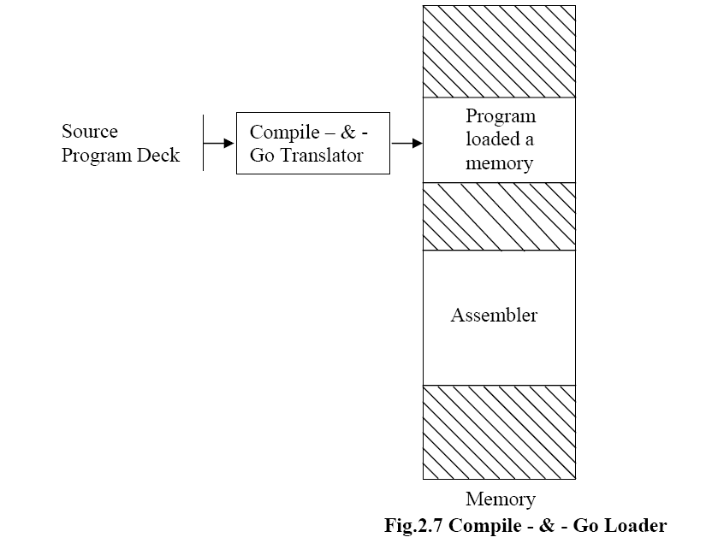
Compile-and-Go Loader
Source program deck

Slide 11
Compile and Go loader
In this scheme assembler run in one part of memory and place object instructions & data, as they are assembled, directly into their assigned memory location.
When assembly is completed, assembler causes a transfer to the starting instruction of the program

Slide 12
Advantages:-
It is relatively easy to implement. Assembler simply places code into core and loader transfer control to starting instruction of newly assembled program.
Disadvantages:-
i) A portion of memory is always occupied by assembler. That portion is unavailable to any other object program.
ii) User’s program have to be reassemble every time it is run.
iii) If source program contains sub routine written in different languages, then different assemblers have to be stored in memory ( i.e. again wastage of memory).

Slide 13
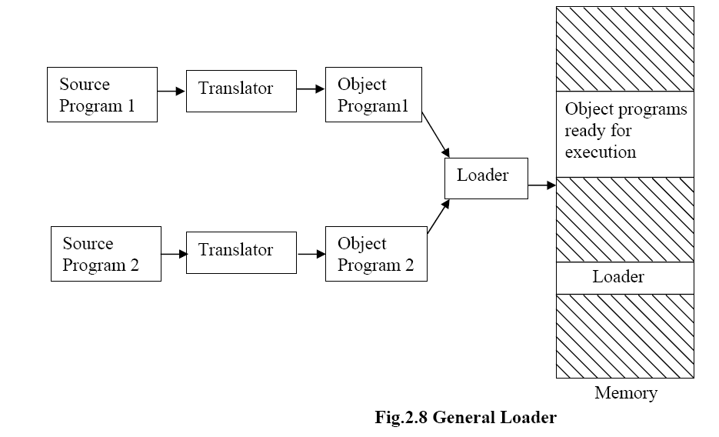
General Loading Scheme

Slide 14
General Loader Scheme
In this scheme the output of assembler is saved and loaded whenever code is to be executed.
Assembled program could be loaded, in the same area into memory where assembler was stored ( because now assembling is completed assembler is removed from main memory).
Function of loader is to accept instruction, data and other information in object format and put it into memory in executable format.

Slide 15
General Loading Scheme
Advantages:-
No need to put assembler in main memory all the time it can be removed after assembly is completed. Assembled program is stored in secondary storage in object form
Loader is required to put object code in memory in executable format, which is smaller in size.
Every time when we run program one do not have to assembler it every time.
Even if subroutine are in different languages, their object code & linkage conventions will be in one language.
Disadvantage:-
Addition of a new program ‘Loader’ into system.

Slide 16
Absolute Loader
100
100
248 248
400
478 400
Object Deck 478
Main Memory
MAIN
MAIN
Absolute
Loader
SQRT
SQRT

Slide 17
Absolute Loaders:-
The simplest type of loader scheme which fits to the general model is called as absolute loader.
Assembler produces object code, which is stored on secondary storage ( instead of directly loaded into main memory like in compile -&-go).
Loader in turn accepts this object code, places it into core at prescribed place by assembler for execution.

Slide 18
Advantages:-
This scheme makes more memory available to the user, an assembler is not in memory at load time.
Simple to implement.
Disadvantages:-
Programmer must specify to the assembler, the address of memory location where program is to be loaded.
When program contains more than one subroutines, then programmer must remember the address of each and have to user it explicitly in other subroutines to perform subroutine linkages.
Programmer must be careful not to assign same or overlapping locations to two subroutines.

Slide 19
Thus in absolute loader scheme four loader functions are performed by
Allocation - by programmer
Linking - by programmer
Relocation - by assembler
Loading - by loader

Slide 20
Subroutine linkage
The problem is:: A MAIN program A wishes to transfer to sub-program B. However the assembler does not know this symbol and declare it as an undefined symbol (error) unless a special mechanism has been provided.
This mechanism has been implemented with a direct-linking or a relocating loader.
The assembler pseudo-op EXTRN followed by a list of symbols indicates that these symbols are defined in another programs.
Correspondingly if a symbol is defined in one program and referenced in others, we insert it into a symbol list following the pseudo-op ENTRY.
The assembler will also inform the loader that these symbols may be referenced by other programs.

Slide 21
Subroutine linkage(Cont…1)
Consider the following example::
MAIN START
EXTRN SUBROUT
----------
L 15, = A(SUBROUT)
BALR 14,15 // reg 14 is return addr of caller.
--------
END
The subroutine can be defined at other location as ::
SUBROUT START
USING *,15
----------
BR 14
END

Slide 22
Relocating loaders
To avoid possible reassembling of all subroutines when a single subroutine is changed, and to perform the task of allocation and linking for programmer, relocating loaders are developed.
In this scheme, assembler assembles each procedure segment independently and passes on the text and information after relocation & inter segment references to the loader.

Slide 23
Example:: BSS(Binary Symbolic Subroutines) loader used in IBM 7094, IBM 1130, etc.
The o/p of a relocating assembler using a BSS scheme is the object program & information about all programs it references.
It also provides the relocating information that needs to be changed if it is placed in an arbitrary place in core.
BSS loader scheme is used on computers with a fixed length direct address instruction format.

Slide 24
5.RELOCATING LOADER(Cont…1)
SOURCE PROGRAM | REL. ADDR RELOCATION OBJECT CODE
MAIN START EXTRN SQRT EXTRN ERR ST 14,SAVE L 1,=F ‘9’ BAL 14,SQRT C 1, = F ‘3’ BNE ERR L 14, SAVE BR 14 SAVE DS F END | 0 00 ‘SQRT’ 00 ‘ERRb’ 01 ST 14,36 12 01 L 1,40 16 01 BAL 14,0 01 C 1,44 01 BC 7,4 28 01 L 14,36 0 BCR 15,14 34 0 skipped for alignment 36 00 temp. location 40 00 44 00
SOURCE PROGRAM | REL. ADDR RELOCATION OBJECT CODE
MAIN START EXTRN SQRT EXTRN ERR ST 14,SAVE L 1,=F ‘9’ BAL 14,SQRT C 1, = F ‘3’ BNE ERR L 14, SAVE BR 14 SAVE DS F END | 0 00 ‘SQRT’ 00 ‘ERRb’ 01 ST 14,36 12 01 L 1,40 16 01 BAL 14,0 01 C 1,44 01 BC 7,4 28 01 L 14,36 0 BCR 15,14 34 0 skipped for alignment 36 00 temp. location 40 00 44 00

Slide 25
5.RELOCATING LOADER(Cont…2)
Absolute Address | Relative Address
BC 15,448
BC 15, 526
ST 14,436
L 1,440
BAL 14,400
C 1,444
BC 7,404
L 4,436
BCR 15,14
(TEMP LOC)
9
3
400 | 0
404 | 4
408 | 8
412 | 12
416 | 16
420 | 20
424 | 24
428 | 28
432 | 32
436 | 36
440 | 40
444 | 44
LENGTH = 48 BYTES.
SQRT
LENGTH = 78 BYTES.
ERR

Slide 26
5.RELOCATING LOADER(Cont…3)
Drawbacks ::
The transfer vector linkage is only useful for transfers & is not well situated for loading or storing external data(data located in another procedure segments).
The transfer vector increases the size of the object program in memory.

Slide 27
6. DIRECT-LINKING LOADER(cont…1)
END
RLD
TXT
ESD
FIG: - OBJECT DESK FOR A DIRECT LINKING LOADER
ESD – External Symbol dictionary.
TXT – Text (contains actual assembled program).
RLD - Relocation & Linkage Directory. – contains information about those locations in the program whose contents depends on the address at which the program is placed. These information are::
Location of each constant that needs to be changed due to relocation.
By what it has to be changed.
The operation to be performed.

Slide 28
DIRECT-LINKING LOADER(cont…2)
ADVATAGES::
It allows the programmer multiple procedure & data segments.
Complete freedom for the programmer to refer the data in other segments.
Provides flexibility in intersegment referencing & accessing ability.
Allows independent translations of the programs.
DISADVATAGES::
It is necessary to allocate, relocate, link & load all of the subroutines each time in order to execute a program.
These loading are Time-consuming.
Although loader is smaller than assembler, it occupies some memory space.

Slide 29
OTHER LOADING SCHEMES
These includes Binders, linking loaders, Overlays & Dynamic loaders.
Binders:: - A Binder is a program that performs the same functions as that of a direct-linking loader in binding subroutines together, but rather than placing the relocated & linked text directly into memory, it outputs the text as a file or a card deck.
This o/p file to be loaded is called as “load-module”.
The functions of binders are ::
Allocation, Relocation, Linking & Loading.
There are 2 major classes of Binders::
Core – image module.( fast & simple)
Linkage Editor.(complex)

Slide 30
Dynamic Loading overlays
Each of the previous loader schemes assume that all of the subroutines are loaded into core at the same time. It the total amount of memory available is less than memory required by all needed subroutines, then there will be trouble.

Slide 31
Solution to above problem can be-
Some hardware techniques like paging and segmentation are used to solve this problem
There is loading scheme called as dynamic loading which is also available to solve above problem.

Slide 32
Usually different subroutines are needed at different times. E.g. PASS1 & PASS2 of assembler are mutually exclusive. Both can be loaded one after another, need not to be loaded at the same time.
By determining which subroutines call another, which are exclusive , we can produce an overlay structure, that will help to use memory economically.

Slide 33
